Slide 1





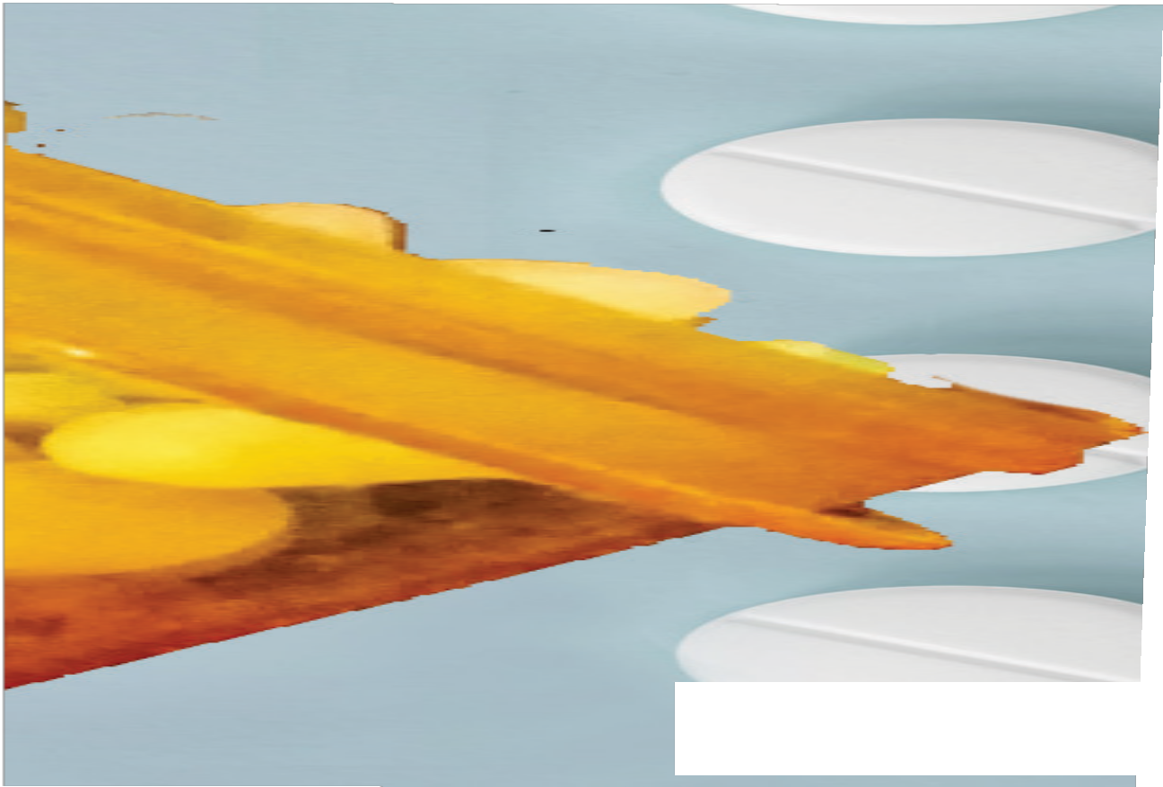








UNDERSTAND
CONTEXTUALIZE
SITE

Slide 2



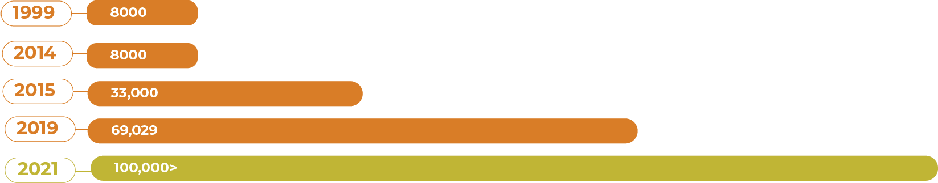

US Overdose History
Data Source: Springboard Recovery
UNDERSTAND
CONTEXTUALIZE
SITE

Slide 3
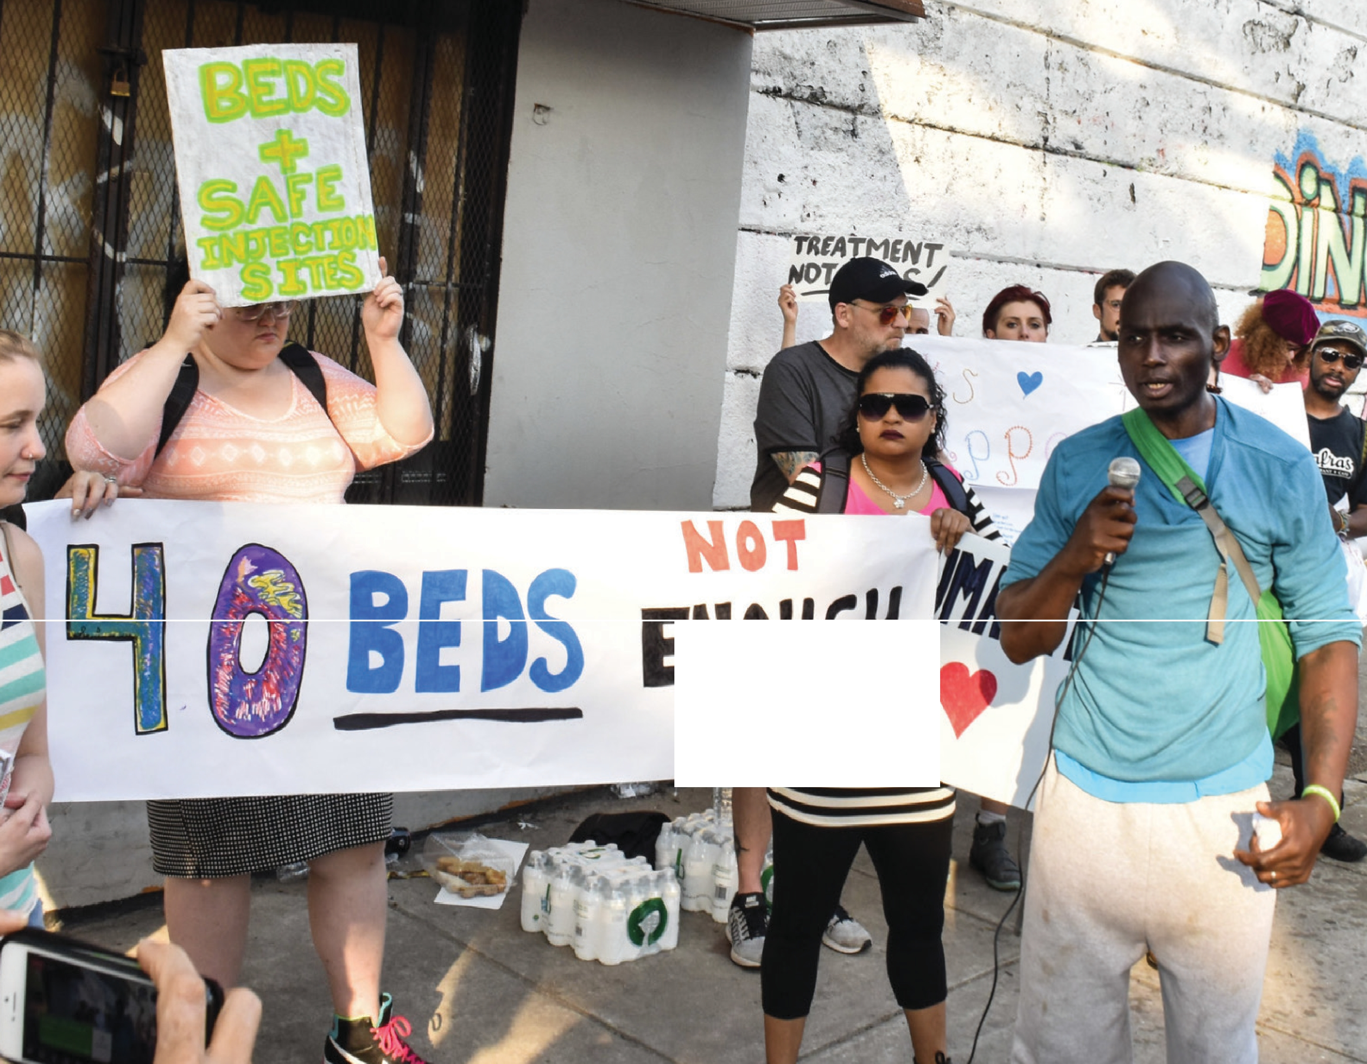
ENOUGH

Slide 4
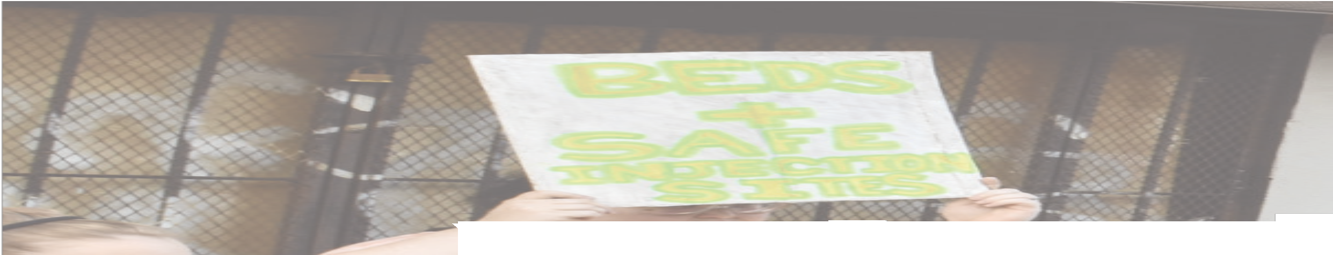
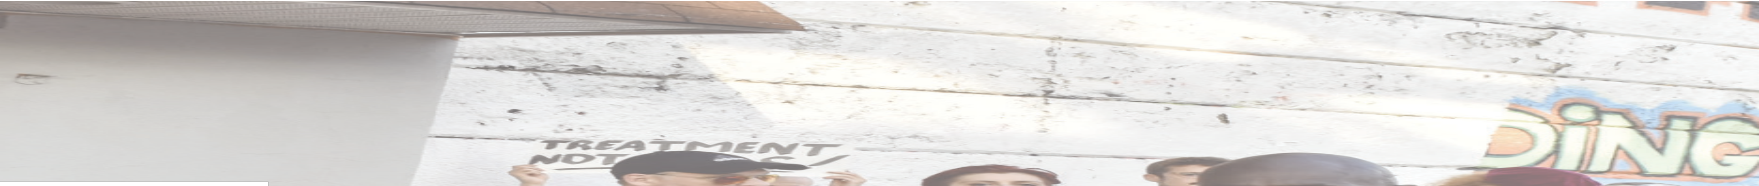




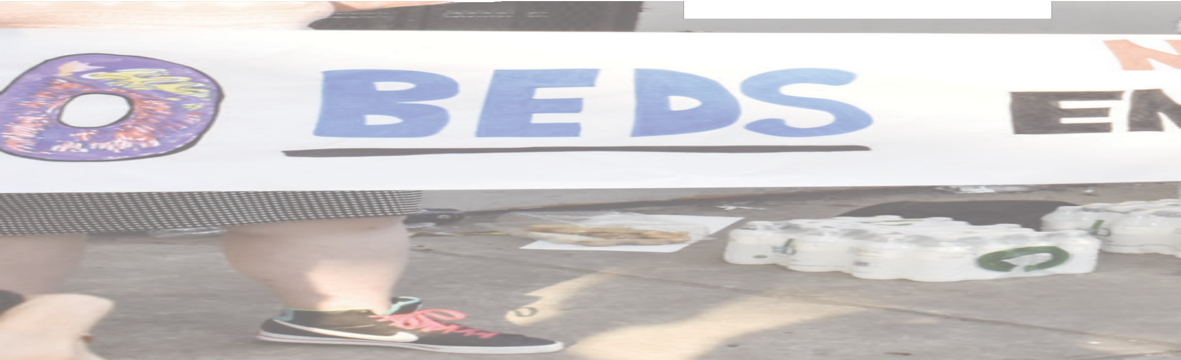
Why ?

Slide 5



New research reveals how our surroundings impact our mental health
Source: The Health Foundation

Slide 6
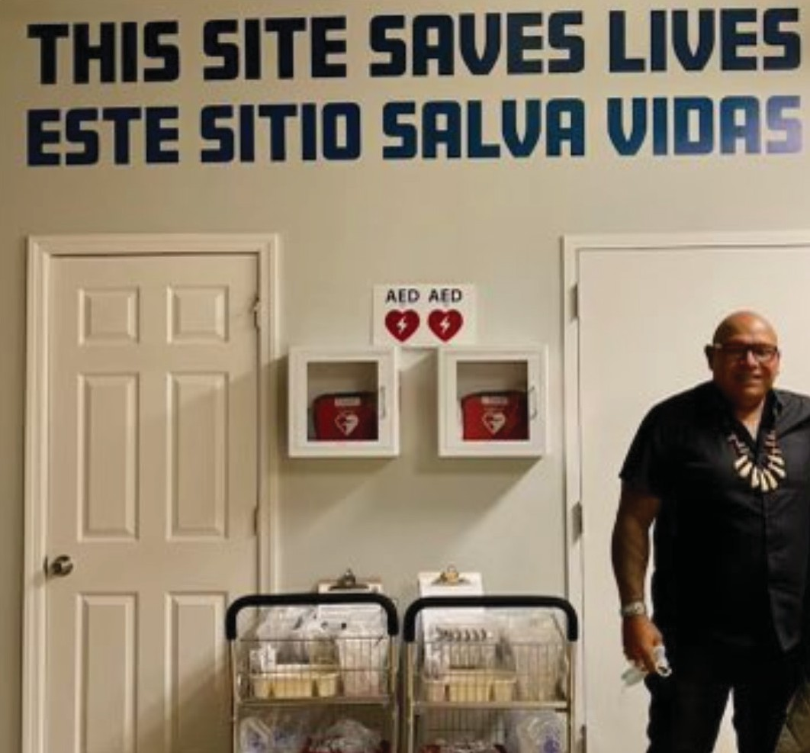



Slide 7
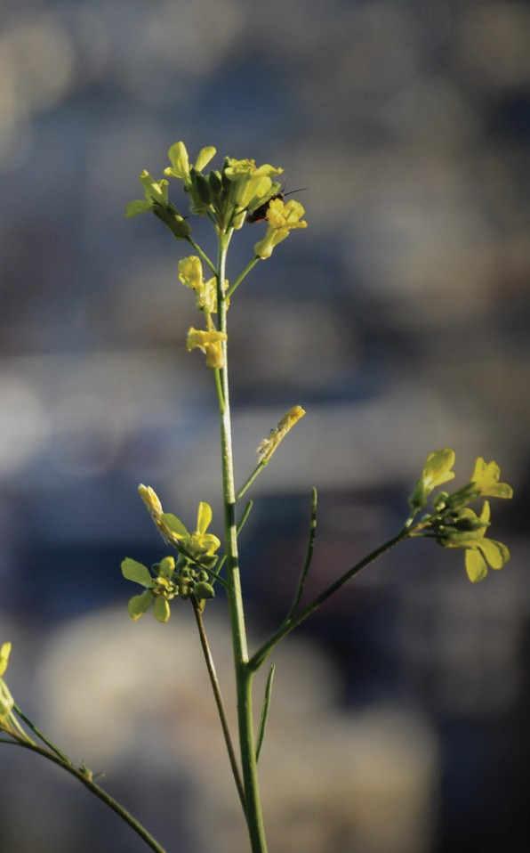






Siting Hope
Overdose Protection Site App

Slide 8
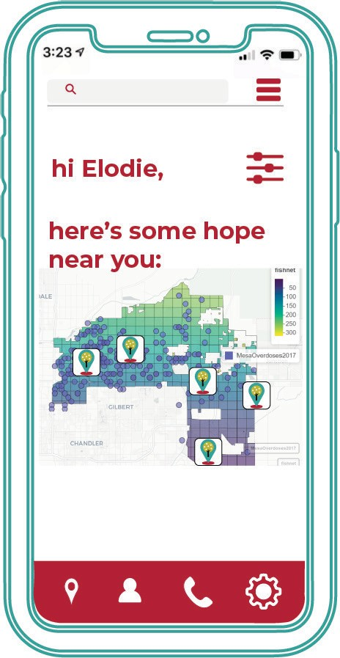
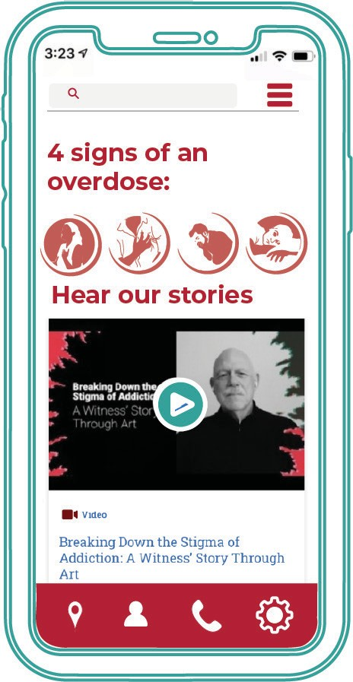


Slide 9
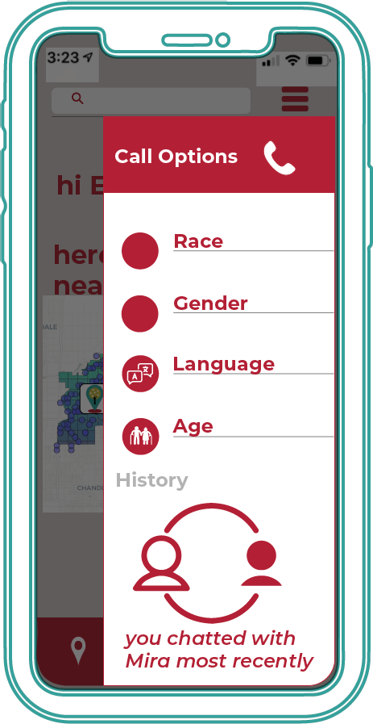
call with
comfort

Slide 10
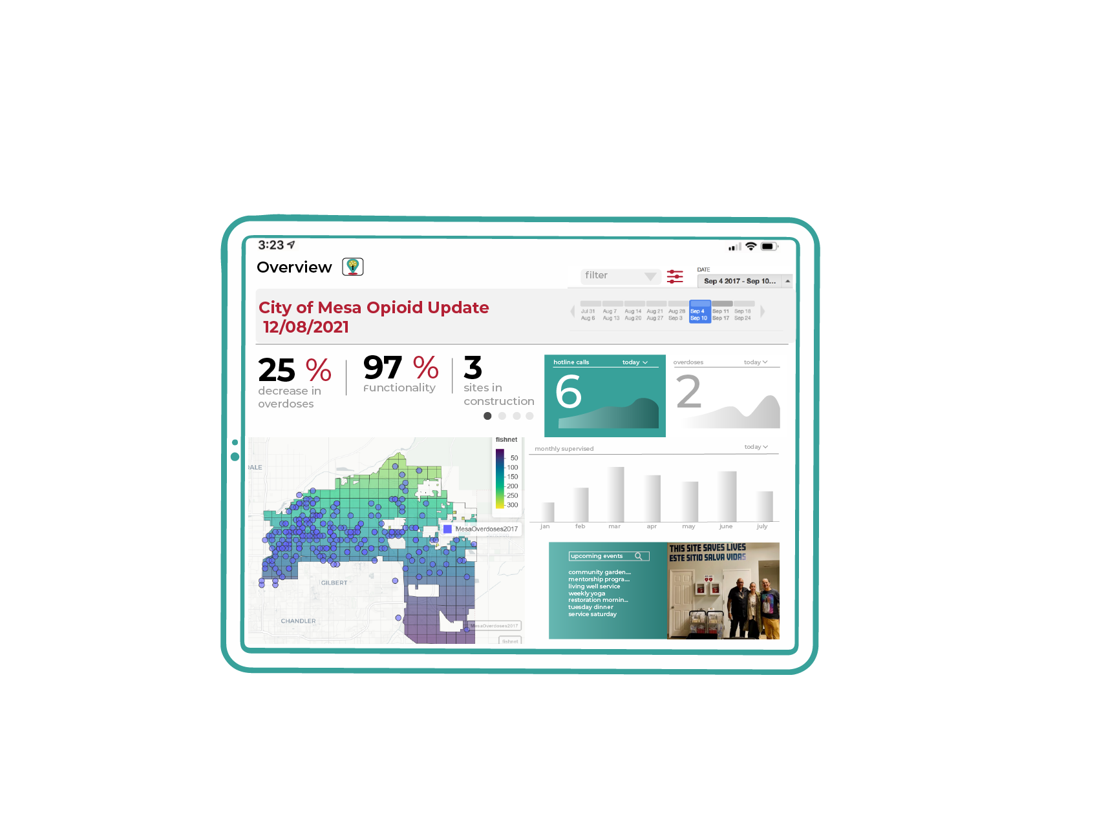
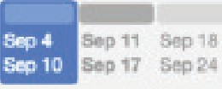

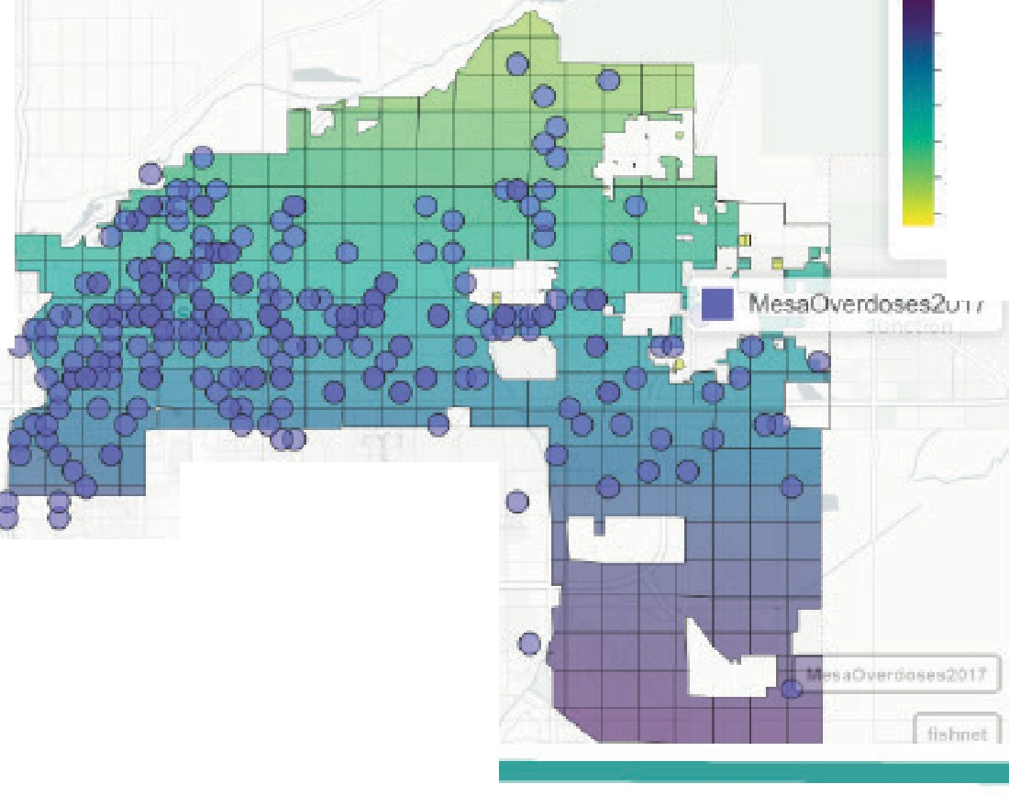

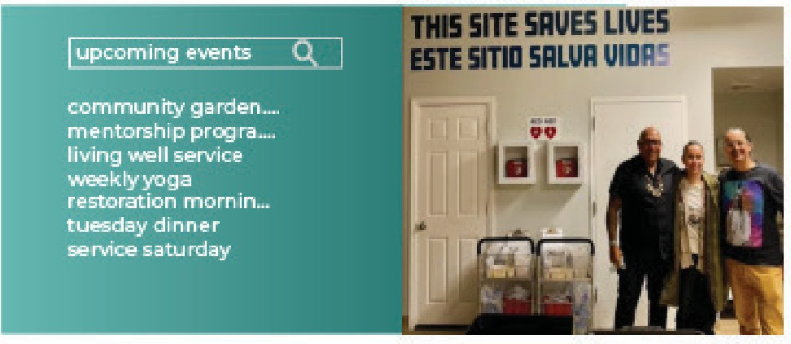

3:23
City of Mesa Opioid Update
12/08/2021
--
111
•..,•
Overview
filter
ll>'.TE
Sep 4 2017 - Sep 10... •
lA 31 ""' 7 ...,g • Aug 21 Aull 2ft , • 6 .-.,,g 13 A.g 2Q Auel 27 5ep J
25%
decrease in
overdoses
97% 3
Functionality sites in
overdoses todayv
2
today V
construction
•
•
IISl'lnl!!
•
monthly supervised
IALE
50
100
150
200
250
300
jan
feb
mar
apr
may
june
JUiy
Gil BERT
CHANDLER

Slide 11



the data
#, time, and type of overdose
health insurance & clinics
age,
sex, race, unsheltered individuals
lightposts, benches, trash bins, signage, green space

Slide 12
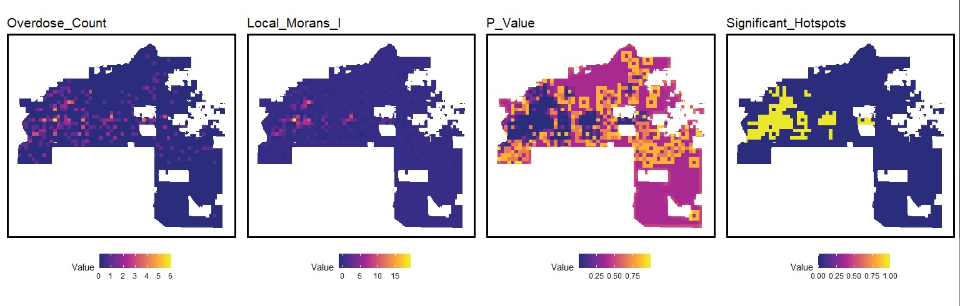
the model

Slide 13
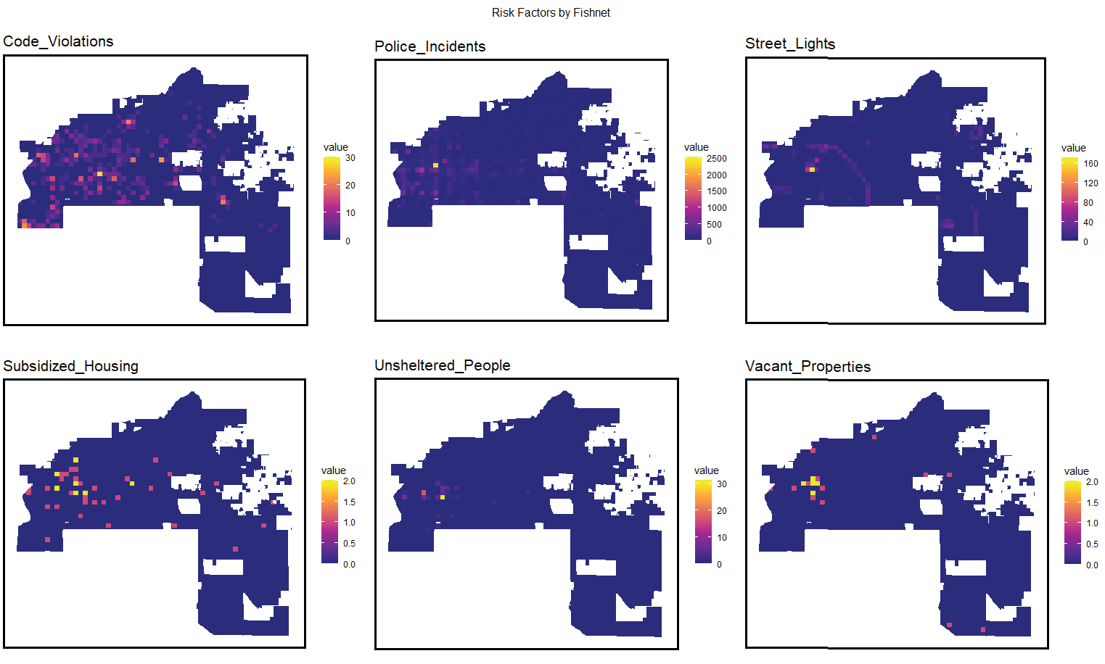

the data features

Slide 14
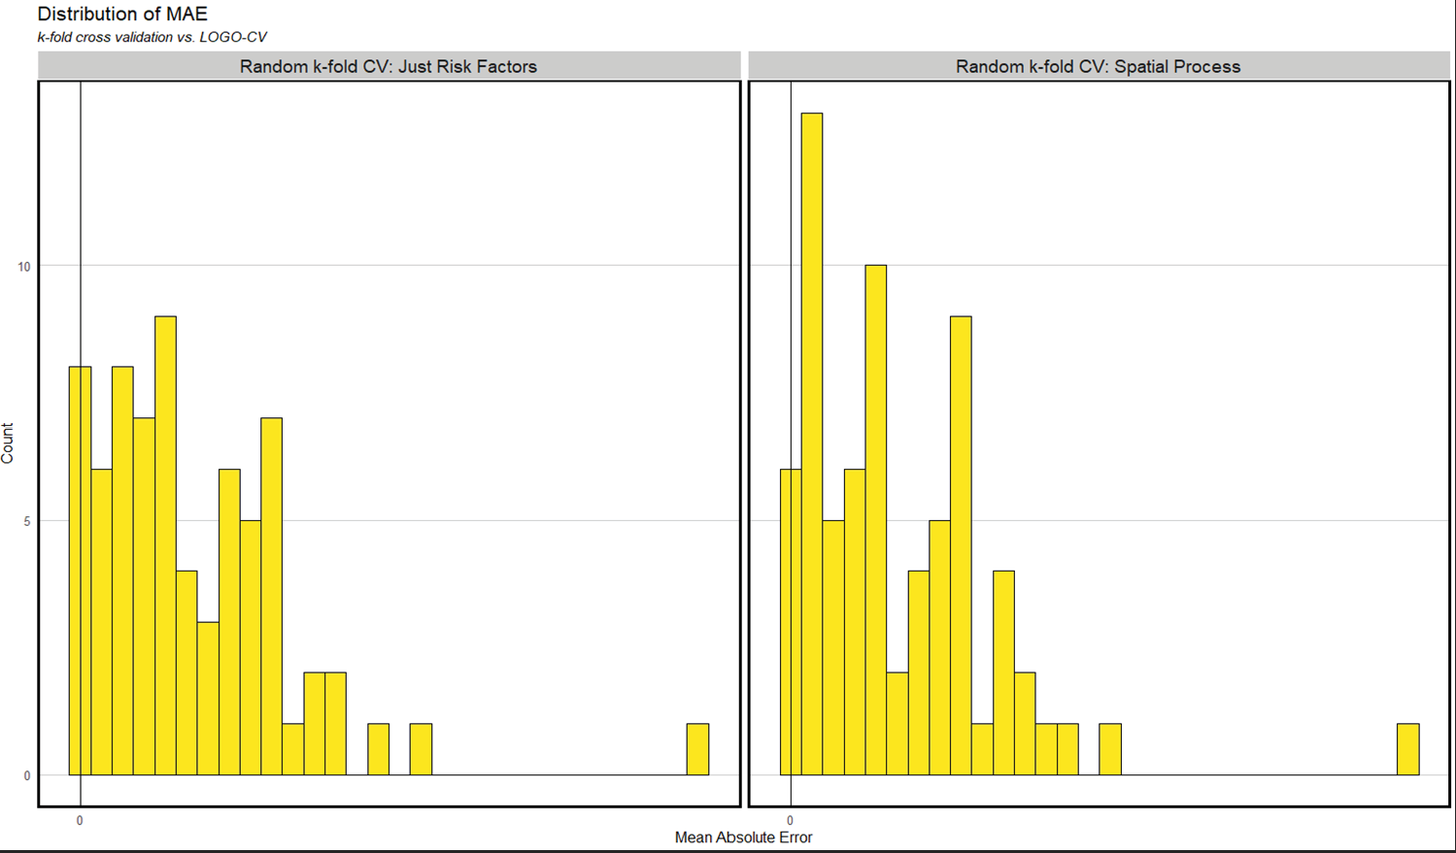
the evaluation

Slide 15
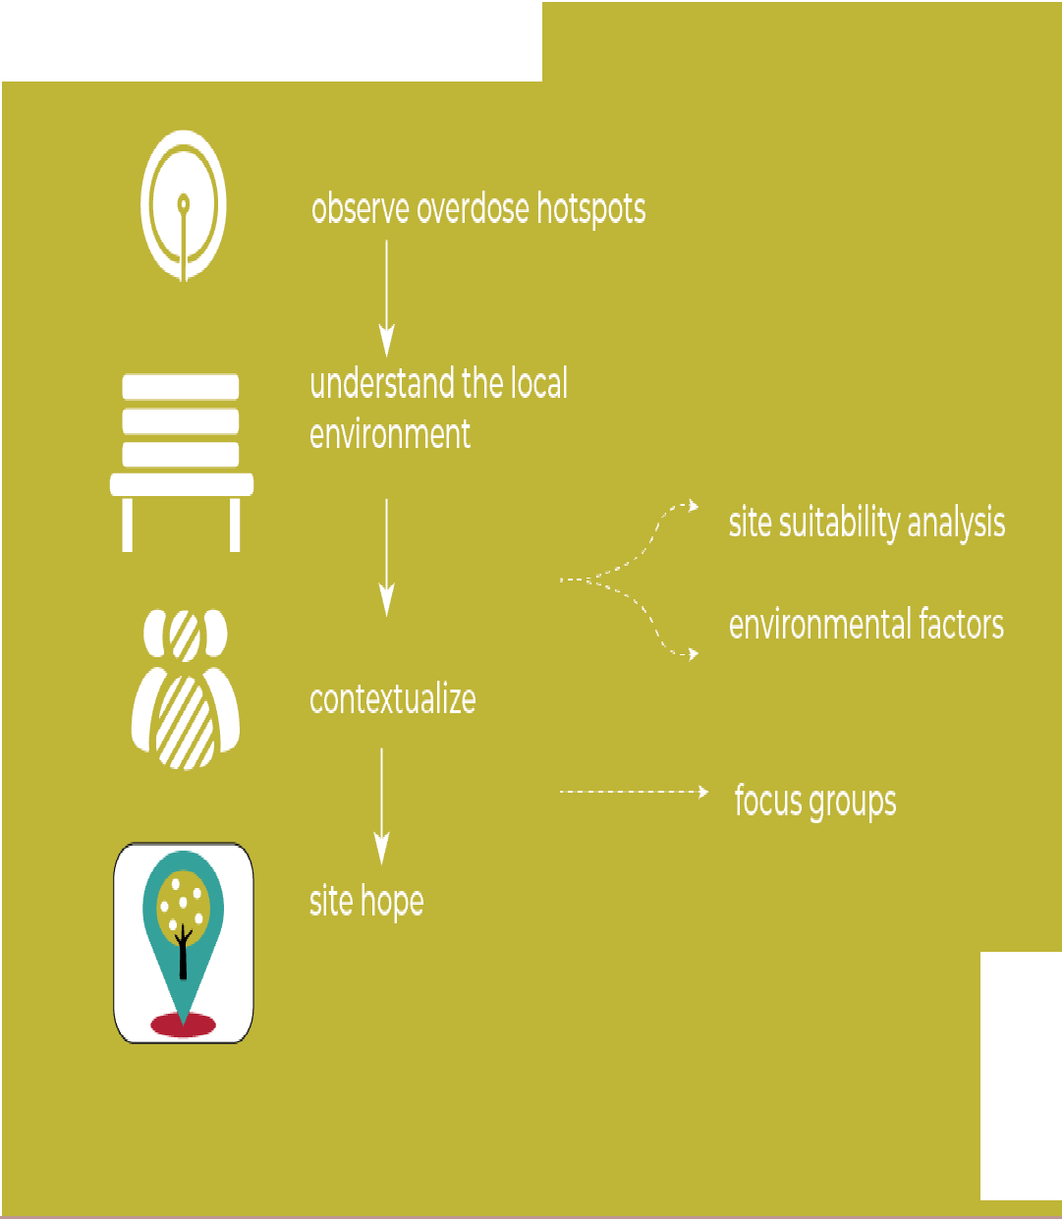

the process

Slide 16




PARTNERS
UNDERSTAND
CONTEXTUALIZE
SITE

